Slide 1
Denial of Shipment of Radioactive Material (Session 3B)
T de Wright, P Gray, A C F Sobriera, U Schwela, C C Xavier
IAEA International Conference on the Safe and Secure Transport of Radioactive Materials
Vienna, Austria
October 19, 2011

Slide 2
Radioactive Materials – Critical Role in
Protecting Public Health & Welfare
Sterilization of single-use medical devices
Disease treatment, diagnostics, therapeutics and palliation
Research and development
Nuclear Energy
Electronics components (tantalum/niobium)
Food safety and agricultural applications
Industrial and safety applications (NDT of welds, pipelines, castings and engines)
Law enforcement & counterterrorism
The radioisotope sector is broad and diverse, long established, with a culture of safety and security
Notes:
As just alluded to, RAM have a broad and significant array of everyday applications ………
2

Slide 3
Specialized Supply Chain
Shipping radioactive isotopes (Class 7) globally (all modes)
Regulatory, safety and security controls established and extensive
International (IAEA, IMO, ICAO), national, local, Port, carrier controls and requirements established
Supplier, container, carrier, customer licensing
Class 7 dangerous goods – internal practices and procedures of supply chain highly controlled
Limited availability of carriers and routes
Frequent regulatory, schedule and routing changes
Denial of shipments is routine and global
Notes:
Since we are obviously dealing with Dangerous Goods when shipping RAM, our Supply Chain is as highly specialized as it is highly regulated – a point which I am sure is well understood by the audience in this room today.
………………
The results, over many decades of package development and transportation, speak for themselves, well noted in the IAEA ….. (NEXT SLIDE)

Slide 4
History of Safe Transport
“Over several decades of transport, there has never been an in-transit accident with serious human health, economic or environmental consequences attributable to the radioactive nature of the goods.”
IAEA International Conference on the Safety of Transport of Radioactive Material, 2003

Slide 5
“Denials” Definition (IAEA ISC)
“an (explicit or implicit) refusal to carry a radioactive shipment though it conforms to all applicable international regulations”
Notes:
The IAEA has defined Denials as ……..

Slide 6
Reasons for Denials: IMO/IAEA Findings
Negative perception about radiation. Lack of awareness and information of the industry and the benefits of these products.
Concerns of cost and extent of training of those who handle radioactive materials (RAM)
Multiplicity and diversity of regulations governing handling, use and transport of radioactive material; lack of harmonization between Member States. Result: duplicative, overlapping and sometimes contradictory regulatory requirements ( i.e. lack of global harmonization to IAEA Code of Conduct)
Lack of outreach with resultant lack of public awareness about the need & applications of radioactive material, and the extremely stringent regulatory environment in which they are managed
Notes:
In analyzing reported denials, the IAEA and IMO have been able to categorize the reasons for denial and significant delay of shipment into 4 areas ………………

Slide 7
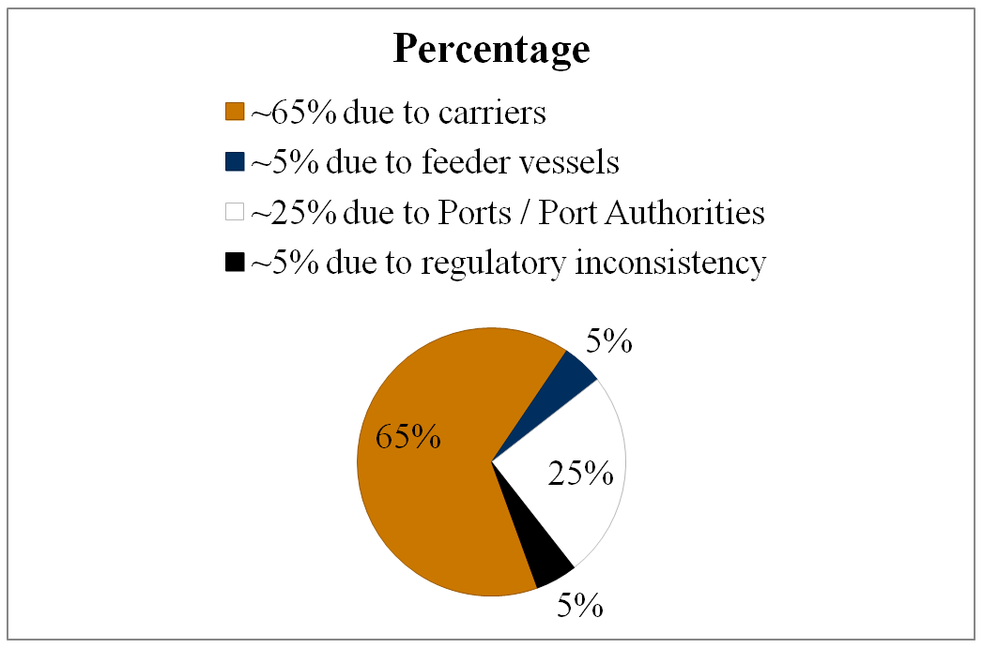
Joint Denial Database: Summary to Date
Since 2009 – 182 reports to Database: denial (92) and difficulties (94) by sea
Of these 108 or approx. 65% have been due to carrier unwillingness to carry the material.
Source: IAEA
Notes:
As of mid-2010 ….. (review stats)
One of the key actions required of all industries and companies producing and shipping RAM products is to document and submit denial reports. If no reports are submitted, the logical conclusion of the IAEA, IMO and ICAO is that there are no delays and therefore no problem and, subsequently, no need for additional time or resources to deal with this serious problem. This is a good example of where we, the industry, can and must help ourselves. This date will quantify the magnitude of the problem, allow root cause determination and allow us to define and implement actions which will mitigate or solve the reasons for denial of shipment

Slide 8
Supply Chain Challenges
Limited number of Ports (air & sea) willing or authorized to handle Class 7
Long sea routes – require transit through multiple ports (and/or trans-shipment) increasing likelihood of inconsistent regulations or one Port denying transit to effectively prevent use of a route.
Frequent routing changes
Frequent vessel capacity and size changes throughout year
Limited number of carriers willing or authorized to handle Class 7
Major air carrier policy prohibiting RAM carriage adversely affects handling capability in large EU hub airport
Captain of vessel discretionary power over loading
Major carrier official statement: “…in principle not opposed to carrying….radioactive cargo” and “…will consider carriage….provided….transit restrictions are lifted…”
Poorly researched and/or sensationalist reporting on purported RAM transport events
Denial or delay of shipments increases the cost to industry and the consumer, reduces inventories of sterile products or availability of nuclear medicine products, and increases the perception of risk associated with the use of radioactive materials
Notes:
8
Yet, even with this highly specialized and successful transportation capability, and an exemplary safety and security record, which is the envy of the vast majority of cargo, especially DG, shippers and carriers, we continue to experience significant challenges in effectively moving our products throughout the world. ………..
8

Slide 9
IAEA International Steering Committee
IAEA International Steering Committee on Denial of Shipment of Radioactive Materials (ISC)
Established 2006; 6th annual meeting held April 2011
Meeting #7 : February 2012
Mandate
To develop and coordinate a comprehensive Action Plan which will facilitate the global transportation of radioactive materials
Membership
~ 40 members : > 20 countries represented, plus IAEA, IMO, ICAO, governmental and non-governmental organizations, industry associations and some specific industries
Notes:
Subsequent to an IAEA Resolution, the IAEA formed the Int’l Steering Comm. On the Denial of Shipment of RAM, which held its first meeting in early 2006, and which will be holding its 6th meeting in early 2011.
……..

Slide 10
A New Structure
International
Regional
National
Notes:
At its fifth meeting early this year, the ISC revised its structure, its relationships within the Committee and with the 2 functional groups established to support its work – the NFPs and the Regional Networks.
Without going into significant detail, the Mgmnt Team is comprised of the Chairman, the 2 Deputy Chairmen and the IAEA, as well as past Chairmen. This group meets via a monthly conference call to monitor and facilitate the actions established by the ISC and which are ongoing throughout the year.
Pivotal to the success of the ISC and the completion of the Action Plan, the NFPs and the Regional Coordinators constitute the ISC

Slide 11
IAEA : National Focal Points (NFP) / Regional Networks (RN)
NFPs
IAEA requested all Member States to nominate a single point of contact (regulatory) to deal with denials – NFP
Have > 80 countries now represented by a NFP, good growth over past year
RNs
Multiple countries assimilated by region (Latin America; EU and Mediterranean; Asia Pacific countries incl. Australia and some Middle East countries; French / English speaking countries in Africa)
Aim - facilitating communication on denials and ultimately facilitating radioactive material (RAM) transport globally
Benefits:
Geographically similar countries working together to resolve “local” denial issues
Global representation at ISC meetings
Specific points of contact in the regions and Member States
Involved for further communication and coordination of actions
Notes:
…………….

Slide 12
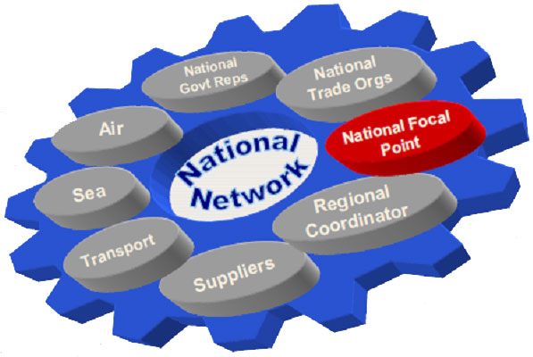
A New Structure
National Govt Reps:
Energy & Resources
Foreign Affairs & Trade
Transport Authority
Customs Authority
National Trade Orgs:
Importers
Exporters
Air:
National Airports
National Airlines
National CAA
National Focal Point:
Assigned
~80 M.S. of 151
Sea:
National Ports
National Shippers
Regional Coordinator:
Provide Training Assistance
5 regions globally
Transport:
Road Freight Companies
Rail Freight Companies
Freight Forwarders
Suppliers:
Medical Industry
Radiopharmaceutical Industry
Isotope Industry
Notes:
This slide provides some detail regarding the interaction of the ISC membership, the global logistical supply chain, producers, shippers and end consumers of RAM products. As you can see, each is an important cog in this wheel, and it is through the annual ISC meetings, the monthly management team meetings, the continually updated Action Plan, the RN meetings and training sessions, the integration with other UN bodies, the integration with appropriate regulatory bodies, and the opportunity to speak about the ISC an dits work at events such as this, that we will be able to move the issue of denails to one of facilitation.
To integrate globally even more actively and quicker, we had fro the first time at the annual ISC meeting this year, a full week session which was comprised of meetings specifically for NFPs, for the RC and then an all inclusive meeting of the ISC with NFPs and RCs.. This action was very positive and provided a great opportunity to have ideas and successes shared, and to integrate the regions of the world in this common cause – recognizing that logistics is not an isolated nor geographically specific process.

Slide 13
IAEA Steering Committee Action Plan
Awareness | Institute a database to record all denials (all modes, all geographies) Access data, define root cause of denials, establish action plan to resolve Educate all parties involved of the very rigorous standards in place regarding transportation
Training | Improve awareness and understanding of transportation supply chain and stakeholders regarding transport safety regulations and experience e-learning package
Communication | Improve the integration and transparency between producers, shippers, users, carriers, authorities, regulators and the Public
Lobbying | For marketing, outreach, and promotion of industries shipping radioactive materials and for promoting a positive image regarding the use of these materials
Economics | Mitigate deleterious & burdensome costs associated with shipping denials & delays
Harmonization | Of international and national regulations and standards, of Port and Port Authority requirements, of carrier requirements and of the process used to report denials of shipments
Notes:
…………..

Slide 14
Actions Underway
New denials and delays brochure
New website : http://goto.iaea.org/denialofshipment/
IAEA/regions consolidating a listing of regulations and differences in regulations impacting RAM transport from all Member States
ISC challenging and educating authors of biased / inaccurate trade journal articles
RC, IAEA, ISC communicating and meeting at Executive level with carrier, Port and related organizations which do not now carry RAM
RAM with medical applications (i.e. Co-60) to be highlighted/utilized in bringing focus to denials in communication (video) strategy
Integrating NGOs involved in shipping process (IAPH, ICS, ICHCA, etc.) into ISC
IAEA/IMO integrating on communication strategy which will focus on both organizations’ general resolutions (communication at DG level)
IAEA to use Technical Cooperation Agreements to help fund ISC actions where required
Notes:
…………….

Slide 15
Case Study: Brazil
Transport of RAM by all modes formerly regulated by CNEN
Pro : training and understanding high amongst producers and users of RAM
Cons : handlers of RAM in transport lacked appropriate training
: lack of information on transport safety and security rules
: lack of information on general benefits of RAM in everyday life
Result : denial & delay in shipping RAM by sea and through Port of Santos
Actions : 1) communication strategy developed and implemented
2) topics : uses of nuclear energy and of RAM in industry / medicine
: fundamentals of radioactivity - characteristics, dose,
biological effects, etc.
: regulations and regulatory organizations
Result : issue of denial resolved at Port resulting in now routine movement of Co-60
through Port
: increased understanding and acceptance by handlers of RAM

Slide 16
Case Study: Australia
The Uranium Council: an industry led forum with representatives from industry, government agencies from State and Commonwealth jurisdictions.
Access to international routes for UOC shipment is fundamental to the Australian uranium industry.
The Council’s Transport Working Group:
addressing transportation issues facing exporters at both the national and international level;
progressing a strategy to identify the current restrictions on uranium transport and reduce the burden faced by both existing and future uranium exporters; and
developing a suite of guidance documents to increase accessibility of information on UOC transportation.
Notes:
The Australian Uranium Council was formerly known as the Uranium Industry Framework (UIF).
The UC was established by the Australian Government in 2007 to develop a sustainable Australian uranium mining sector in line with world’s best practice in environmental and safety standards.
The UC is chaired by an industry person and the Secretariat for the Council is provided by the Australian Government Department of Resources, Energy and Tourism.
The Transport Working Group is progressing a strategy to identify the current restrictions on uranium transport and reduce the burden faced by both existing and future uranium exporters. Strategy goals include:
Increasing availability of shipping transport routes
Continuing efforts to open new ports to transit and trans-ship UOC
Exploring options for inter-coastal shipping routes
Examining options to increase the efficiency of UOC transport
Continuing efforts to encourage carriers to accept Class 7 Goods
Developing recommendations for Government consideration
In the past year the Working Group has been developing a suite of guidance documents including
Best practice guide on the transport of uranium
Analysis of the Chemical and Radiological Safety of drummed UOC
Guideline on emergency response
Guidance on creation of incidence response action plans for the transportation of UOC
This work complements work done in the past to develop a transport mapping model, and information sheet.
Transport Mapping Model
Information Sheet for the Safe and Effective Transport of Uranium (2007)
It gives a short description of uranium, its uses, transportation and packaging requirements.
It outlines the safeguards and permit requirements and explains the risks, basic radiation protection, first aid and safety measures.
It has been widely circulated both domestically and internationally to government, industry, shipping and port organisations.
The World Nuclear Transport Institute has recently created a similarly focused brochure.

Slide 17
Status
Positive in many areas
New carriers (air & marine) now carrying RAM (ZIM, Evergreen, KLM, etc.)
UN focus on denials issue at highest levels (GC at IAEA, FAL at IMO, ICAO)
Increased interest in denials at national & regional levels
RAM with medical focus now a poster child (plans for video re. Co-60)
RN very active, creative and getting results
RAM transport reputation very positive amongst carriers moving it
Increasing number of marine and air carriers now competing for RAM business
Required actions :
Denial reports need to be submitted in timely manner via your NFP to IAEC/IMO/ICAO
Ongoing work required in some geographies
Industry - know who your NFP and RC is, talk with them regarding your issues
Government – put in place a NFP if not already done, and support their role
Notes:
………………..

Slide 18
The Future
The IAEA has set the target of reducing delays and denials to an insignificant level by 2013
Action Plans in place and integrated at country, regional and international levels
Momentum and resources increasing
Increased education regarding denial issue and increasing reporting of denial to IMO / IAEA/ICAO (No Report = No Denial) underway
Turning Denials into Facilitation
ISC Denials Website: http://goto.iaea.org/denialofshipment/
Notes:
……………….

Slide 19
Conclusions
Exemplary safety and security record
RAM is very highly regulated from point of manufacture to point of use
Supply chain is highly trained and licenced to carry Class 7
Government and industry controls in transport and Customs clearance are stringent
Time sensitive nature and end use of medical RAM products requires reliable, effective and efficient transportation and export / import processes
Denials and delays of RAM transport continue and must be resolved, with focus on carriers, Ports and Member States
Integration, harmonization, and consistency of regulatory processes and practices critical to supply chain effectiveness
Industry, working together and with regulators, with the IAEA/IMO/ICAO, and with the supply chain, is turning denials of transport into facilitation of transport
Notes:
…………………..

Slide 20
Thank You
Notes:
…………………..

