Slide 1
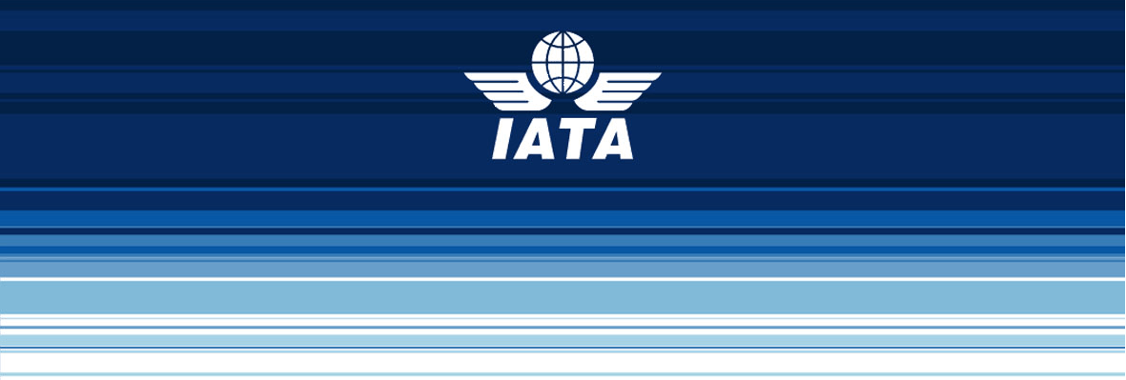
Industry Response to Denial of Shipments

Slide 2
Industry Response to Denial of Shipments
What is IATA?
IATA Dangerous Goods Activities
IATA Denial of Shipments Activities
Industry Concerns

Slide 3
What is IATA?
Trade association of the world’s airlines
Founded in 1945 by 30 airlines in Havana, Cuba
Incorporated in Canada by a special Act of Parliament
Now has 230 airlines comprising 93% of international scheduled air traffic.

Slide 4
IATA Dangerous Goods Activities
Overseen by the IATA Dangerous Goods Board (DGB) – 12 Member airlines;
Voting member of the ICAO Dangerous Goods Panel
Observer status at the meetings of the UN Subcommittee of Experts;
Member of the IAEA TRANSSC and Steering Committee on Denial of Shipments.
Notes:
The IATA Dangerous Goods Board meets 2 times per year. The upcoming meeting in early 2012 will be the 100th meeting of the group of airline experts. Through the IATA dangerous goods board and in cooperation with ICAO, we develop the IATA Dangerous Goods Regulations, soon to be published in its 53rd Edition. With that same material we also publish information to specific groups, like infectious substance shippers and ground handling staff to assist them with information developed for and targeted to them.
IATA presents papers to the ICAO DGP based on industry response. We do much of the same at the UN, however we do not hold a voting status there. Through our work the UN, ICAO and the IAEA, we are constantly trying to improve the safe transport of dangerous goods, the understanding of the Regulations and the application of the Regulations.

Slide 5
IATA Dangerous Goods Activities (Cont’d)
Training Standards developed by the IATA Dangerous Goods Training Task Force (DGTTF);
Deliver training through our IATA Training and Development Institute using qualified instructors and standardized materials;
A network of accredited training schools.
Notes:
IATA’s DGTTF has been around for a number of years, developing training standards for all aspects of the IATA DGR.
The develop standard material, instructor qualifications, validate training programmes and develop proposals to the IATA DGB.
The standard material and instructor qualifications from this group are to a higher standard than the minimum requirements found in the Regulations.
IATA delivers training as well. Through our ITDI directly using qualified instructors and standardized materials.
We also have a network of accredited training schools who submit their material to IATA for accreditation and when they meet the high standard, they may issue certificates with an IATA logo on it.

Slide 6
IATA Dangerous Goods Activities (Cont’d)
Outreach and awareness
Industry events (Lithium battery seminar, workshops, World Cargo Symposium, etc)
Trade organisations (COSTHA, DGAC, etc)
Notes:
IATA’s DGTTF has been around for a number of years, developing training standards for all aspects of the IATA DGR.
The develop standard material, instructor qualifications, validate training programmes and develop proposals to the IATA DGB.
The standard material and instructor qualifications from this group are to a higher standard than the minimum requirements found in the Regulations.
IATA delivers training as well. Through our ITDI directly using qualified instructors and standardized materials.
We also have a network of accredited training schools who submit their material to IATA for accreditation and when they meet the high standard, they may issue certificates with an IATA logo on it.

Slide 7
IATA Denial of Shipments Activities
Support the work of the IAEA:
At TRANSSC; and
the Denial of Shipments Steering Committee
Work with ICAO and the UN on safe, sound Regulation
UN SCoE
ICAO DGP
Notes:
Supportive of the IAEA’s work.
Participated in the Regional workshops, continue to participate at the steering committee. Support at TRANSSC on the Regulations.
Regulations must be practical, economically sound and advance safety.
Optimum balance between safety and economic considerations.
A change in the balance causes an overall decrease in safety.

Slide 8
IATA Denial of Shipments Activities (Cont’d)
Evaluate/Validate dangerous goods training programmes, including class 7
Work with membership on issues and understanding the Regulations.
Work with interested parties on issues and understanding the Regulations.
Notes:
Our operator validation program ensures that airlines have material that is consistent on an international level. Airlines who participate have their material peer reviewed to ensure best practices are used. This includes Class 7 training material when such airlines accept Class 7. There is an opportunity for the airline(s) to learn from others, as well as benefit from the knowledge that their material meets a high standard. The result of such a program is a consistent approach amongst participating airlines.
One of our biggest roles is working with our members on any issues that arise. Examples of this might include working with shipper’s to correct documentation, working with airlines to ensure the intent of the Regulation is understood, working with Ground Handlers to accept cargo, sometimes with minor errors or omissions that do not affect safety. We do this by speaking with the interested parties and where necessary, liaising with the experts in the governing body (IAEA, ICAO, local government, etc…).

Slide 9
Industry Concerns
(dis)Harmony
Regulatory misalignment
Different rules for different modes and countries.
Authority misalignment
Transport Authority Vs. Radiation Protection
Communication
Notes:
Air transport continues to have some issues when it comes to denials and delays. Some delays are operational in nature, where the aircraft itself might have been delayed. Taking those aside, there are other delays, where the Regulations may have been misunderstood. Here is where the parties involed can benefit greatly from communication. Where the Regulations are unclear, there is a process to have them fixed. For example, IATA may receive such a comment and bring it to ICAO, the UN or the IAEA for clarification and new text.
Addressing any misalignment in the Regulations, is one method that ensures smooth, efficient transport. Unfortunately, the Regulations are not always aligned. Just recently, there was an issue regarding a new State variation effectively prohibiting the transport of Radioactive material. The industry response there was that there needs to be more communication on such issues. If/when such legislation goes into affect, industry needs time to react and adjust, otherwise, as in this case, many shipments can be stopped or slowed.
Many States have regulations for radioactive materials for radiation protection, etc. that impact on transport:
Specific storage areas;
Licensing of personnel;
Radiation protection advisor, etc.
Requirements of State variations and national regulations create conditions for operator variations, e.g. prohibit or restrict acceptance/carriage of radioactive materials;
Transport regulations for Class 7 are complex and they are indeed different from the Regulations for other classes of dangerous goods. They include significant requirements not applicable to other classes of dangerous goods; This means training for staff is different, handling, processing and transport is also different. Such differences can create issues and unnecessarily complex processes.
Most airlines carry dangerous goods on passenger aircraft. Prime business is carriage of passengers, which means that issues can and do arise regarding the priority of load. IATA recently participated here in Vienna to the Denial of Shipments Steering Committee where this very issue was raised. In the working group, it was agreed that the best way to overcome such issues is a good communication plan.
A communication plan that can overcome another issue of public perception of radioactive materials. Many, including the staff working for the airline, ground handler, airport authority believe that radioactive material is nuclear weapons / nuclear power.

Slide 10
NO TYPE OR IMAGES CAN TOUCH THE SKY
Thank You
Brendan SULLIVAN
Manager, Dangerous Goods and Training Standards
Phone: +41 22 770 2030
Email: sullivanb@iata.org
International Air Transport Association IATA Centre, 33 Route de L’Aéroport, PO Box 416 1215 Genève, SWITZERLAND www.iata.org/dangerousgoods

