Slide 1
International Conference on the Safe & Secure Transport of Radioactive Materials Transport 17-21 October 2011, Vienna, Austria Session 1A: Where Are We Today? Modal Structure: Rail, Road, Sea and Air
Khammar MRABIT
Director, Office of Nuclear Security Department of Nuclear Safety and Security

Slide 2
Background
Transport: very complex issue requiring harmonization
Problems were increasingly being encountered at seaports, airports and rail yards where dangerous goods were trans-shipped
International transport has to deal with at least (if transshipment) 2 regulatory systems (instruments)
Several modes of transport (with dedicated regulations)
Responsibility is with the consignor (for safety) when it is within the State (each) for security
Large array of Stakeholders (customs, regulatory bodies, operators, shippers for all modes, …)

Slide 3
Background (Cont’d)
Transport: very complex issue requiring harmonization
Nuclear security of transport of nuclear material to prevent the unauthorized removal of such material and to prevent theft and sabotage leading to potential unacceptable radiological consequences
Specific Transport regulations for safety and for security issues, for nuclear and for other radioactive material, for each mode of transport
How has the international community organized itself to face this complexity and the challenge of harmonization?

Slide 4
General Scheme
Level 1 (Global)
Level 2 (Global)
Level 3 (Global / Regional)
Level 4 (National)
Safety
issues
Radioactive Material Transport Requirements
Modal Transport Provisions
Modal Transport Provisions
National DG Transport Provisions
Dangerous Goods Transport
Requirements
Modal Transport Provisions
Modal DG Transport Provisions
RAM
Nuclear Material Transport Recommen-dations
Security issues
National NM Transport Provisions
NM
Convention

Slide 5
Level 1: Class 7 transport – Safety issues
Legitimacy of the IAEA
IAEA Statute (III.A.6:establish or adopt safety standards)
Entrusted by ECOSOC
TS-R-1 “IAEA Regulations for the Safe Transport of Radioactive Material”
Elaborated by IAEA and MSs and approved by BoG
Incorporated in UN Model Regulations (completely since 1999)
6 guides (TS-G-1.X) complete TS-R-1 (2005 & 2009 edition)
Transport principles
Prevent accidents to persons or property and damage to the environment
Make transport feasible by reducing risks to a minimum

Slide 6
Level 1: Class 7 transport – Security issues
Legitimacy and Role of the IAEA
IAEA Statute (Articles II, III.A.6 and XII),
BoG and GC resolutions (Nuclear Security Plans),
Security Council resolutions 1373 (2001) and 1540 (2004)
Facilitate adherence to and implementation of the legal framework
Transport of Nuclear Material
Convention on the Physical Protection of Nuclear Material (1980)
Binding instrument (1987) for international transport
Scope: physical protection of NM used for peaceful purposes
Considering Theft and Unauthorized Removal for building IND
Deal with criminalization of certain offences and international cooperation

Slide 7
Level 1: Class 7 transport – Security issues (cont’d)
Transport of Nuclear Material
2005 Amendment to CPPNM
Extension to nuclear facilities and to domestic transport
Expanded cooperation between and among States
rapid measures to locate and recover stolen or smuggled nuclear material,
mitigate any radiological consequences of sabotage and
prevent and combat related offences
Considering sabotage and radiological consequences
NSS-13 (INFICIRC/225, Rev.5 (2011))
“Nuclear Security Recommendations on Physical Protection on Nuclear Material” - For international and national transport
To achieve effective physical protection against the theft or unauthorized removal of nuclear material and against the sabotage by individuals or groups

Slide 8
Level 1: Class 7 transport – Security issues (cont’d)
Transport of Other Radioactive Material
NSS-14 (2011)
“Nuclear Security Recommendations on Radioactive Material”
Complementary to NSS-13
Related to Code of Conduct for Safety and Security of Radioactive Sources
Two related implementing guides:
NSS-09 with definition of security levels (basic and enhanced) and high consequence radioactive material (with dedicated security plans) and
NSS-11 (Radioactive Sources, 2009)

Slide 9
Level 1: Class 7 transport Safety/Security issues
Three sets of Requirements/Recommendations:
Safety - TS-R-1;
Security of Nuclear Material (NSS-13); and
Security of other Radioactive Material (NSS-14)
→ Challenges:
Consistency between sets of Requirements and Recommendations
Harmonization

Slide 10
Level 2: All Classes transport
ECOSOC as integrator
Legitimacy of SCETDG (ECOSOC Resol.), with UNECE Secretariat
UN Model Regulations
Need for consistency
Basis for Model Regulations
TS-R-1 consistent with the framework and general principles of UN Orange Book (UNOB)
Differences between UN Model Regulations and TS-R-1
2 sets of recommendations mainly evolving independently
→ How should the interface IAEA-SCETDG (TS-R-1 /UNOB) work ?
→ Consistency between Safety Requirements for Class 7 and other classes?
→ Does it work for Security Recommendations?

Slide 11
Level 3: Modal transport of all Classes
Global Scheme – through binding instruments
At global level (for air and sea transport)
Technical Instructions of ICAO through Chicago Convention
IMDG Code through SOLAS Convention
At regional level (for land transport)
European Agreement concerning the International Carriage of Dangerous Goods by Road (ADR)
European Agreement for the International Carriage of Dangerous Goods on Inland Waterways (ADN)
International Carriage of Dangerous Goods by Rail (RID) through COTIF
MERCOSUR/MERCOSUL Agreement (road and rail transport)

Slide 12
Level 3: Modal transport of all Classes (Cont’d)
Sea Transport
United Nations Convention on the Law of the Sea (UNCLOS) (adopted in 1982)
Safety Of Life At Sea Convention (SOLAS)
SOLAS Convention 1974, entered into force on 25 May 1980
Carriage of Dangerous Goods in packaged form (by sea) shall be in compliance the relevant provisions of the IMDG Code (Reg. 3 of Part A of Chapter VII of SOLAS Convention)
International Maritime Dangerous Goods (IMDG) Code
Mandatory for the 159 contracting parties to SOLAS Convention
Amendment 34-08 includes the requirements of TS-R-1 (2005 edition) and security provisions (and the recommendations) of 15th edition of UN Model Regulations.

Slide 13
Level 3: Modal transport of all Classes (Cont’d)
Sea Transport
Code for the Safe Carriage of Irradiated Nuclear Fuel, Plutonium and High-Level Radioactive Wastes in Flasks on board Ships (INF Code)
Mandatory since 2001 through Reg. 15 in Part D of Chapter VII of SOLAS Convention
Ship carrying INF cargo complies with the INF Code requirements
International Ship and Port Facility Security (ISPS) Code
Chapter XI-2 of SOLAS Convention
Security provisions, not specifically on security of dangerous goods
Convention for the Suppression of Unlawful Acts against the Safety of Marine Navigation (SUA)
The 2005 Protocol to the 1988 SUA Convention expanded the scope to include provisions on nuclear material.
Adopted in October 2005, entered into force on 28 July 2010.

Slide 14
Level 3: Modal transport of all Classes
Air Transport
Chicago Convention
On International Civil Aviation, Binding instrument (1947)
Annex 18 = international standards and recommended practices for the safe transport of dangerous goods by air
Technical Instructions of ICAO
Mandatory for the 190 contracting parties to Chicago Convention
2011-2012 edition of the Technical Instructions of ICAO include TS-R-1 (2009 edition) and security provisions (and the recommendations) of 16th edition of UN Model Regulations
Dangerous Goods Regulations of IATA
Not mandatory
In practice, airlines continue to require compliance with IATA’s current DGR (Updated every two years)

Slide 15
Level 3: Modal transport of all Classes
Land Transport (for Europe, Central Asia, Middle East and North Africa)
2011 edition of ADR, RID and ADN = include TS-R-1 (2009 edition) and security provisions of 16th ed. of UNOB.
ADR, RID and ADN = applicable for international transport and national transport (in EU countries)
Road transport (ADR)
ADR, Binding instrument (1968), under the auspices of UNECE
47 ADR contracting Parties:
Inland waterways transport (ADN)
ADN, Binding instrument (2008), under the auspices of UNECE
17 ADN contracting Parties in Europe
Rail transport (RID)
RID, Binding instrument (1980), under the auspices of OTIF
45 Contracting States to COTIF

Slide 16
Level 3: Modal transport of all Classes
Land Transport (Outside Europe, Central Asia, Middle East and North Africa)
MERCOSUR/MERCOSUL Agreement of Partial Reach to Facilitate the Transport of Dangerous Goods
signed by Brazil, Argentina, Paraguay and Uruguay
regulates road and rail transport of dangerous goods, including radioactive material, between these States.
includes the requirements of ST-1 (1996 edition) and the recommendations of 12th edition of UN Model Regulations (security provisions appeared only in the 13th edition,2003).
Revised edition under preparation with the requirements of TS-R-1 (2009 edition) and the security provisions (and the recommendations) of 17th edition of UN Model Regulations.
Other agreements under preparation (South America, Africa, Asia)

Slide 17
Level 4: Implementation in National Law
Regulatory framework
First responsibility of each and every State
Directly depending on the adherence to and ratification of legal instruments
Large array of Conventions and agreements, in connection with:
The transport of dangerous goods
All modes of transport
Physical protection of nuclear material

Slide 18
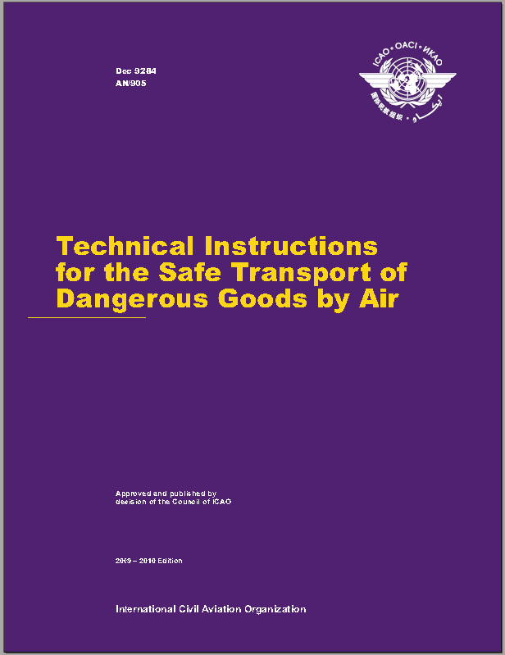
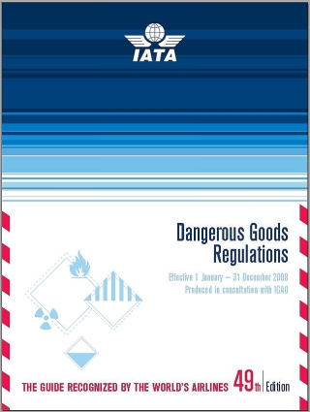
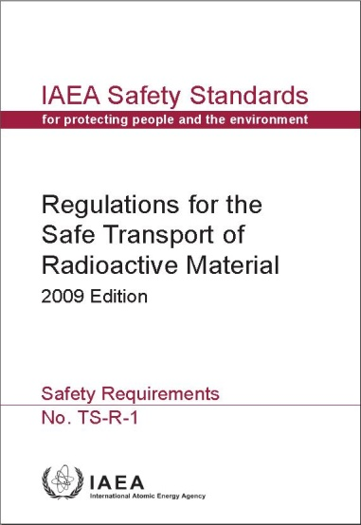
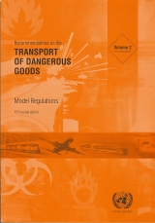
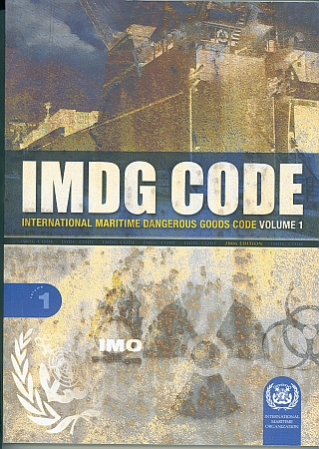
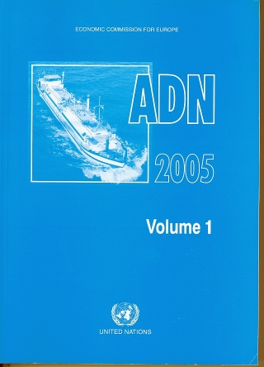
Comprehensive Regulatory framework for Transport Safety
The implementation of IAEA Regs into the Model and Modal Regulations
(190)
Class 7
All modes
All 9 Classes
All modes
Air
Mail
Sea
(192)
(159)
Land transport Road, Rail and Inland Waterway
Regional: MERCOSUR/MERCOSUL (4) ADR (47), RID (45), ADN (17)
18

Slide 19
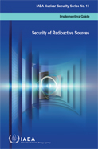
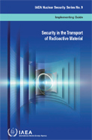
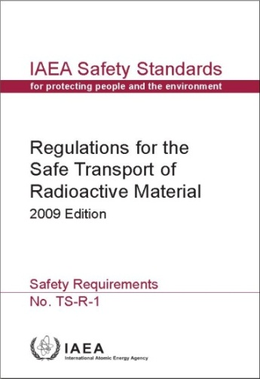
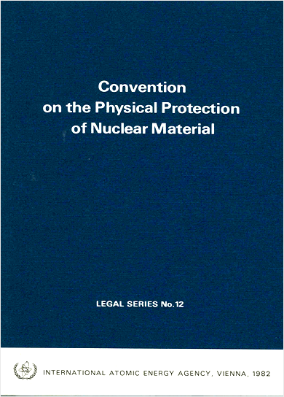
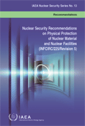
A Regulatory framework for Transport Safety and Security
Class 7 Radioactive Material
?
Mode specific
All 9 Classes
All modes
All 9 Classes
One mode
?
National Law
All modes
NSS-14 (NSS-09, NSS-11)
Nuclear Material
All modes
?
National Law
?
NSS-13 (through CPPNM)
19

Slide 20
Transposition of Safety and Security in National Legislation and Regulations
SAFETY
National Law
Modal Regs
UNOB
TS-R-1
Radioactive Material
Nuclear Material
CPPNM NSS-13
NSS-14 (NSS-09 NSS-11)
UNOB
Cat III material (with potential radiological consequences) or below Cat III
Modal Regs
National Law
SECURITY

Slide 21
Conclusions
It is crucial that:
Member States fully participate in the elaboration of Requirements/Recommendations;
Member States commit to ratify international instruments;
The Agency continues strengthening interface / synergy between safety and security, and then
The Agency, the UN and other specialized Agencies further strengthen their interface and cooperation.

Slide 22
Conclusions (Cont’d)
Efforts to ensure harmonization of requirements and recommendations in transport safety and security should continue:
Among the Modes of Transport;
Among the different Classes of Hazards;
Between Safety and Security; and
Between Nuclear Material and Other Radioactive Material.

Slide 23
Thank you - Q&A

Slide 24
Level 3: Modal transport of all Classes
Postal Transport
Universal Postal Union Convention
Universal Postal Convention signed in Vienna on 10 July 1964.
The Universal Postal Union (UPU) regulates the international postal services of its 192 member States
The Convention requires that the activity of the radioactive contents does not exceed 1/10 of the activity limits prescribed for excepted packages, as defined by and in compliance with IAEA Transport Safety Regulations (TS-R-1, edition 2009).

