Slide 1
Australian Experience in Implementing Transport Safety Regulations and Transport Security Recommendations
International Conference on the Safe and Secure transport of Radioactive Material: The Next Fifty Years- Creating a Safe, Secure and Sustainable Framework, 17-21 October 2011, Vienna
Samir Sarkar¹
Operations Services Branch
Australian Radiation Protection and Nuclear Safety Agency
PO Box 655, Miranda, NSW 1490, Australia
² Fax: 61-2-9541 8348; Email: Samir.Sarkar@arpansa.gov.au

Slide 2
SCOPE
Australian Regulatory Framework
Regulatory Approach
Examples- Spent Fuel and UOC
Assurance of safety and security in regulations
Conclusion

Slide 3
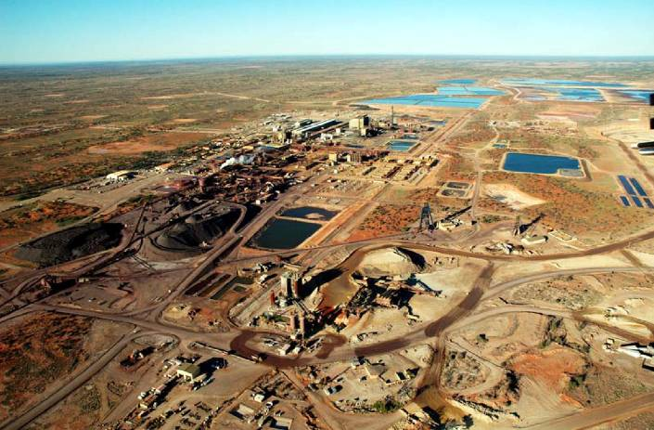
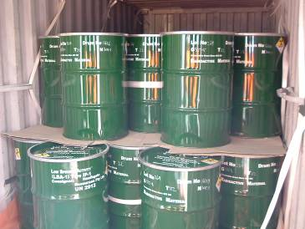
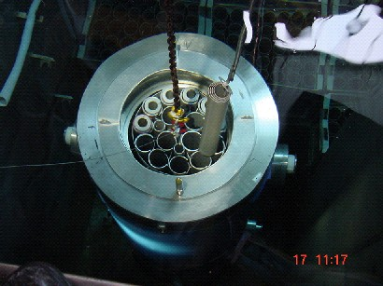
Australia’s Nuclear Industry

Slide 4
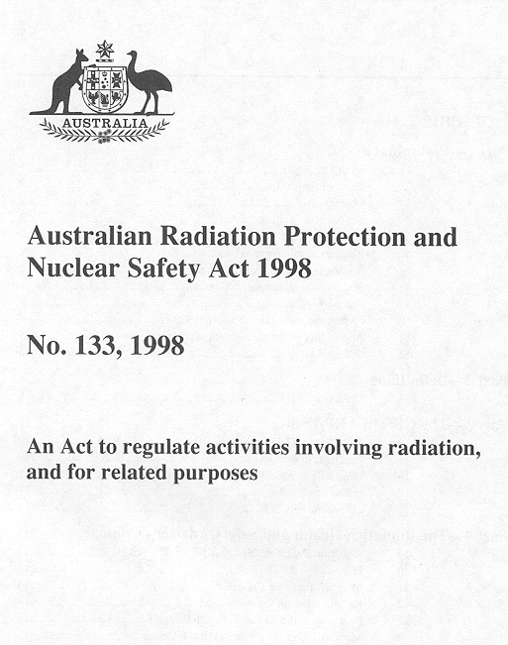
Australian Radiation Protection and Nuclear Safety Act 1998
Commonwealth Legislation
Promulgated 5 Feb 1999
Object of the Act
‘To protect the health and safety of people, and to protect the environment from the harmful effects of radiation’

Slide 5
ARPANS Act 1998
Provides for regulation of radiation dealings and facility conducts
Provides a system of licensing for facilities and dealings (prohibitions), with conditions
Provides powers of inspection, enforcement

Slide 6
Australian Radiation Protection and Nuclear Safety Regulations 1999
Provide more detailed information on:
licensing and licence conditions
reporting by licence holders
practices to be followed by licence holders
inspection
enforcement

Slide 7
REGULATORY CONSIDERATIONS
Non-prescriptive but provides guidance
Licence holder bears prime responsibility for safety
Regulatory process is outcome-focussed, risk-based, consistent, transparent, accountable and responsive
Accountability of licence holder and regulator
Code of Practice, Regulatory guideline, Regulatory Assessment Principles and Criteria reflect international best practice
Consistent with the States and Territories

Slide 8
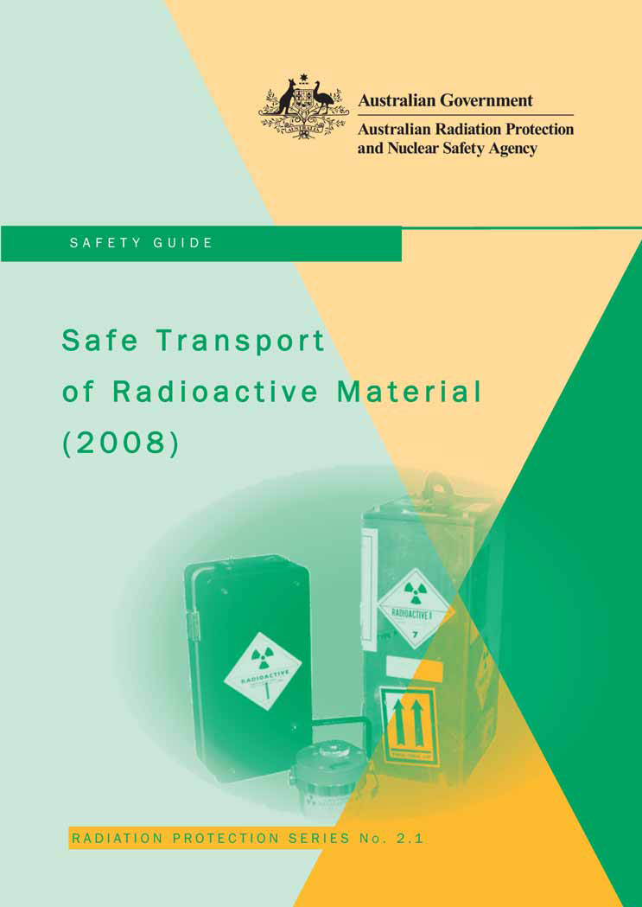
Transport Safety Code

Slide 9
Australia’s Safety Regulatory Framework
ARPANS Act & Regulations
Commonwealth
(Road, rail & inland waterways)
ARPANSA Code of Practice based on IAEA TS-R-1
Civil Aviation Act
(Air Transport)
TS-R-1 through ICAO Technical Instructions
Six States and two territories
(Road, rail, inland waterways)
Implement ARPANSA Code
Marine Order 41
(Sea Transport)
IMDG Code
Transport Competent Authority Forum- National WG to discuss all relevant regulatory matters & uniformity

Slide 10
ARPANSA Approach
Use of deterministic approach through
Conservative rules and requirements
Use of proven technology, defence in depth
Adequate safety margins
Regulatory Inspections
Provides compliance assurance through
Independency
Appropriate expertise
Revision of the Code of Practice, safety Guide

Slide 11
Risk Assessment
Key areas:
Engineering System
Nuclear & radiation safety & security
Human factors
Emergency arrangements
Physical security & Protection system

Slide 12
Spent Fuel Transport (Regulatory Oversight)
Prior assessment of the safety case
ARPANSA Approval of transport plan (Security plan approves by ASNO) followed by AMSA
Planned and reactive inspections
Vessel Inspection by AMSA
Pre- and post monitoring of transport route by ARPANSA
All agency coordination, briefing and debriefing
A total 2281 fuel assemblies in 9 shipments

Slide 13
ARPANSA’s Regulatory Process in Spent Fuel Transport
ARPANSA Assessment
ARPANSA Approval/Validation Certificate
Request for Additional Information
Adequacy of Information
No
Transport Plan Application for Approval/Validation
Yes
Applicant Shipment Preparation
ARPANSA Monitoring of Cask Loading
Pre-shipment Monitoring
Shipment Complete
Post-shipment Monitoring
Shipment Debriefing

Slide 14
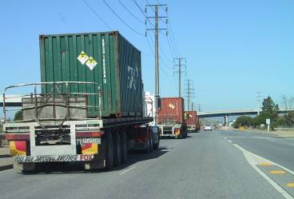
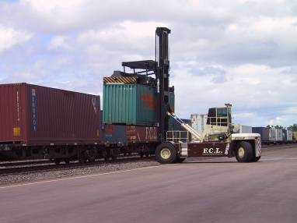
URANIUM MINING AND TRANSPORT
Three operating uranium mines producing and exporting ~10,000 t uranium ore concentrates (i.e. yellowcake) per year.
Transported in 205 l drums in standard shipping containers.
over 500 containers shipped/yr in 30-40 shipments, for delivery to conversion facilities in the US, Canada and France.
Transport in Australia trucks or rail
International transport on standard cargo container ships
uranium carried with other standard goods and products.
Source: S Bayer, ASNO

Slide 15
Australia’s Security Regulatory Framework
Australia has two regulators for security of radiological materials:
ARPANSA – security of radiological sources
Under Regulation 4R of the Customs (Prohibited Imports) Regulations 1956 and Regulation 9AD of the Customs (Prohibited Exports) Regulations 1958 ARPANSA issues permits for import and export of radioactive material
ASNO – security of nuclear materials (U, Th, Pu)
ASNO issues permits under Customs (prohibited exports) Regulations 1958

Slide 16
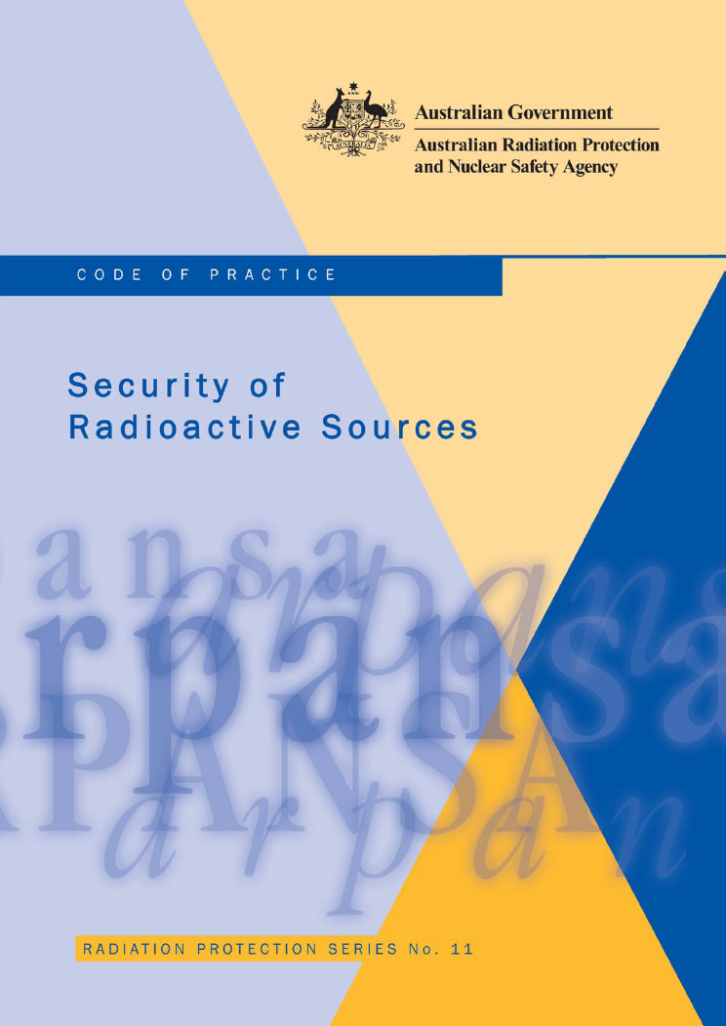
ARPANSA legislation requires complying with this Code.
Implementation through
Legislation for Use, Transport and Storage in all States and Territories
Published: 2007

Slide 17
ASNO’s Responsibilities and Functions
National authority responsible for the administration of the Nuclear Non-Proliferation (Safeguards) Act, including permits for possession and transport of nuclear material – safeguards and physical protection
Operation of WMD treaties and arrangements
fulfilment of Australia’s treaty commitments
cooperation with treaty organisations
contribution to, and assessment of, effectiveness of treaty regimes
ASNO has extensive experience in training and outreach on safeguards and physical protection.
Source: S. Bayer, ASNO

Slide 18
Nuclear Security Legislation
The principle object of the Safeguards Act is to give effect to certain obligations that Australia has as a party to the NPT, Australia’s safeguards agreement with the IAEA, and other bilateral safeguards agreements
bilateral safeguards agreements include an obligation to apply INFCIRC/225to nuclear material
A further object of this Act is to give effect to certain obligations that Australia has as a party to the CPPNM

Slide 19
ASSESSING THE THREATS AND RISKS
2004 ASIO completed full security risk review of the uranium industry, including mine and transport infrastructure.
- led to new permit requirement to have built-in scalability
Threat assessments to U mining and transport based on ASIO National Security Threat Assessment levels using Australian Government risk-assessment methodology
- threats assessed against a pre-determined DBT for the uranium mining and transport sector.

Slide 20
A Risk Based Approach to Protective Security
The Security Code applies a risk based approach to the protective security of radioactive sources through:
performance based outcomes for timely detection scaled on source category; and
prescriptive based procedural and administrative requirements (mandatory, not optional) scaled on the Category of the source and the assessed level of threat.

Slide 21
Performance Based Outcomes Example: Category 1
When being transported, a Category 1 security enhanced source must be protected by, at a minimum, physical security measures capable of providing sufficient delay to allow immediate detection and assessment of the intrusion, and for a guard or police service to interrupt unauthorised access to the source

Slide 22
Scalable (Prescriptive) Based Outcomes Examples
review of transport security plans
review of access control arrangements
review of physical barriers
review of staff access requirements
security awareness briefings
audit of all sources
exercising of response arrangements
The regularity of these actions is dependant on the source category and the currant threat level

Slide 23
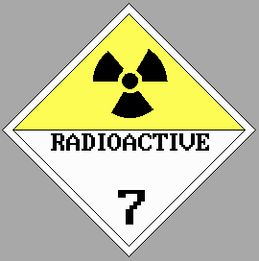
Protective Security (PS) Design and Evaluation Process
Design PS & Prepare
Security Plan
Define PS Requirement
Revise PS and/or Security Plan
Evaluate Security Plan
N
Plan OK?
Y
Implement
Security Plan
Compliance
Monitoring

Slide 24
Conclusion
risk-informed, performance-based regulatory process
Provides assurance in achieving object to the Act (to protect the people and environment )
No transport of incident of significant radiological consequence
The regulation of transport security of sources in Australia is still in the implementation phase as the commonwealth, states and territories amend Acts and Regulations to authorise safety regulators to regulate source security
Meanwhile, ARPANSA are conducting security training for all stakeholders and assessing Transport Security Plans

Slide 25
Acknowledgement
Dr Stephen Bayer, ASNO
Adrian Tusek, CASA
Mr Peter Ellis, ARPANSA
Mr Lubi Dimitrovski, ANSTO
Ref.: IAEA, TECDOC-1436

